Slide 1
Gradient Descent

Slide 2
Today’s Outline
Gradient descent
General optimization algorithm
Issues with gradient descent

Slide 3
Training phase of most ML
Input: labeled data
Define objective / loss metric
Specific loss functions for classification
Run an optimization procedure to minimize loss (error) on training data
Output: trained model that best fits the training data
The process of using algorithms like gradient descent to minimize a function is sometimes called optimization.

Slide 4
Why we need Gradient Descent?
After training your model, you need to see how well your model is performing.
While accuracy functions tell you how well the model is performing, they do not provide you with an insight on how to better improve them.
A Cost Function is used to measure just how wrong the model is in finding a relation between the input and output.
Cost function allows us to evaluate model parameters.
Gradient Descent is an algorithm that is used to optimize the cost function or the error of the model. It is used to find the minimum value of error possible in your model
GD is an algorithm to update the values of model parameters to find the best model.
Notes:
https://www.simplilearn.com/tutorials/machine-learning-tutorial/cost-function-in-machine-learning#:~:text=For%20the%20Linear%20regression%20model,minimum%20of%20these%20error%20values.

Slide 5
Objective/Cost Function
Cost function
measures the performance of a machine learning model for given data
Quantifies the error between predicted and expected values
present that error in the form of a single real number
Depending on the problem, cost function can be formed in many different ways.
The purpose of cost function is to be either:
Minimized: The returned value is usually called cost, loss or error. The goal is to find the values of model parameters for which cost function return as small a number as possible.
Maximized: In this case, the value it yields is named a reward. The goal is to find values of model parameters for which the returned number is as large as possible.
The process of finding the best model according to a loss function is called model fitting. The goal of model fitting is to find the minimum of the error curve.

Slide 6
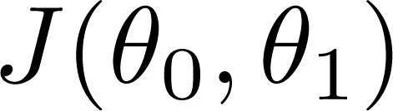
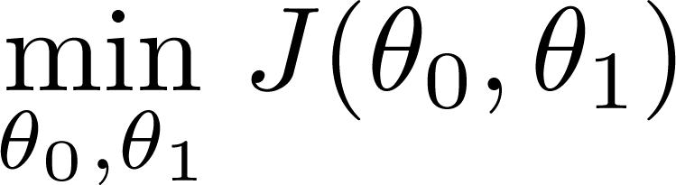
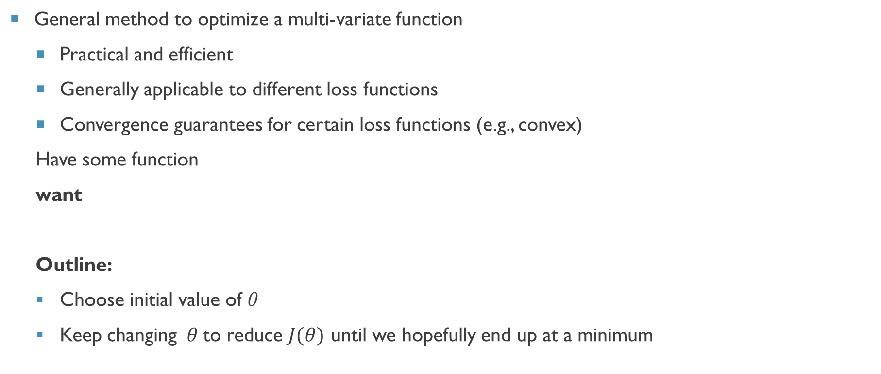
How to optimize loss functions $J(θ)$?
General method to optimize a multi-variate function
Practical and efficient
Generally applicable to different loss functions
Convergence guarantees for certain loss functions (e.g., convex)
Have some function
want
Outline:
Choose initial value of $θ$
Keep changing $θ$to reduce $J(θ)$ until we hopefully end up at a minimum

Slide 7
What Strategy to Use?

Slide 8
Follow the Slope
Follow the direction of steepest descent!

Slide 9
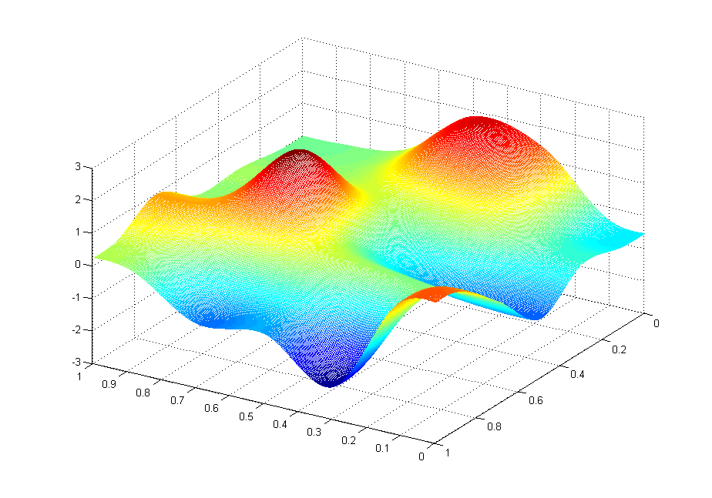

J(θ₀,θ₁)
θ₁
θ₀

Slide 10
Gradient Descent algorithm
• Gradient
slope of line tangent to curve
• Larger learning rate => larger step
Notes:
Since we need a method in which we do not use predetermined values of θ, lets start by picking a random value of θ and see what our loss is.
After this, we will decide whether to increase the current value of θ or decrease it and the amount to increase or decrease.
Lets look at the direction and amount separately.

Slide 11
Gradient Descent

Slide 12
Gradient Descent

Slide 13
Gradient Descent: direction and amount
When the curve is steep, the adjustment will be large, as the slope is greater in magnitude at those points.
When the curve is nearly flat, the adjustment will be smaller, due to less slope.

Slide 14
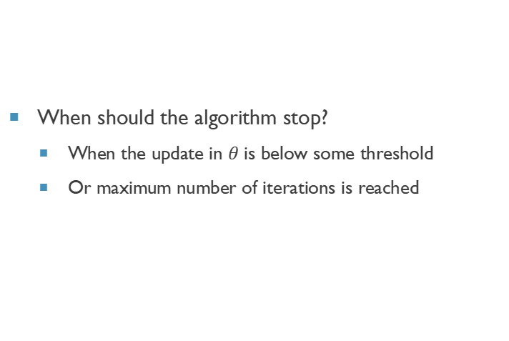
Stopping condition
When should the algorithm stop?
When the update in $θ$ is below some threshold
Or maximum number of iterations is reached

Slide 15
GD Convergence Issues

Slide 16
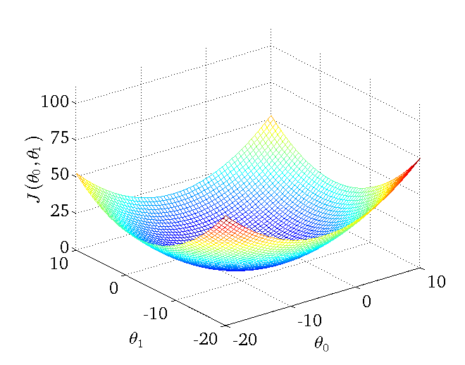
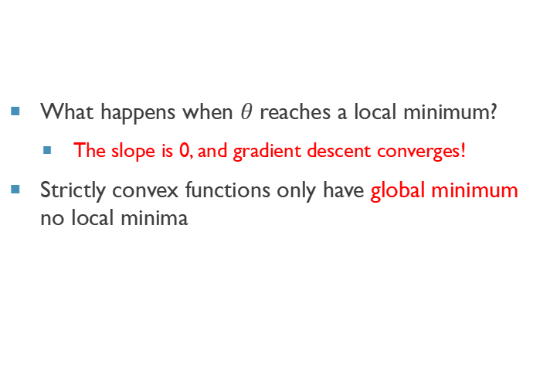
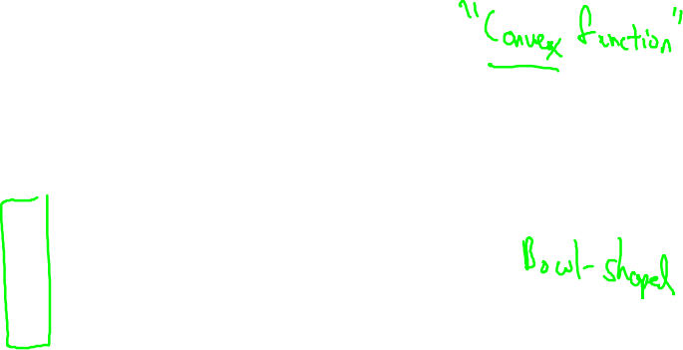
GD Convergence Issues
What happens when $θ$ reaches a local minimum?
The slope is 0, and gradient descent converges!
Strictly convex functions only have global minimum no local minima

Slide 17
GD Convergence Issues: Complex loss function
Complex loss functions are more difficult to optimize as they have multiple local optima

Slide 18
GD Convergence Issues
Local minimum: Gradient descent stops
Plateau: Almost flat region where slope is small
Solution: start from multiple random locations

Slide 19
J(θ₀,θ₁)
θ₁
θ₀
Possible Solution

Slide 20
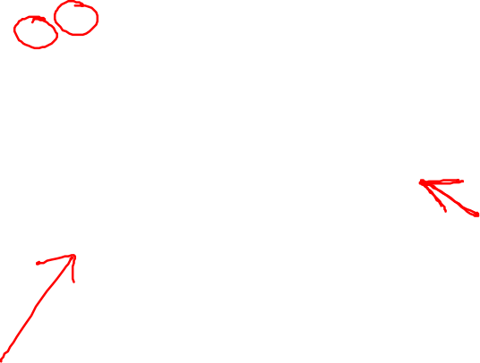
J(θ₀,θ₁)
θ₁
θ₀
Possible Solution

Slide 21
Choosing Learning Rate

